Slide 1
Algebraic Topology and Decidability in Distributed Computing
Maurice Herlihy
Brown University
Joint work with Sergio Rajsbaum, Nir Shavit, and Mark Tuttle

Slide 2
Overview
Applications of algebraic topology
  to fault-tolerant computing
  especially decidability issues
Known results
  focus on techniques

Slide 3
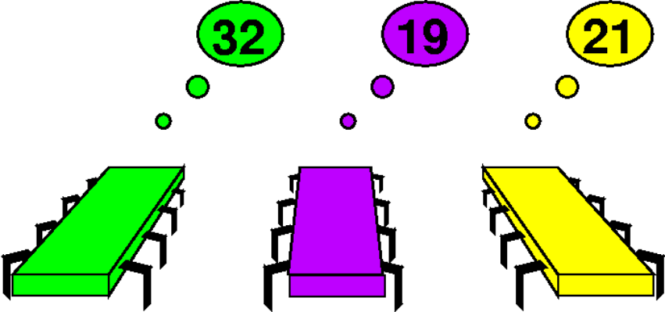
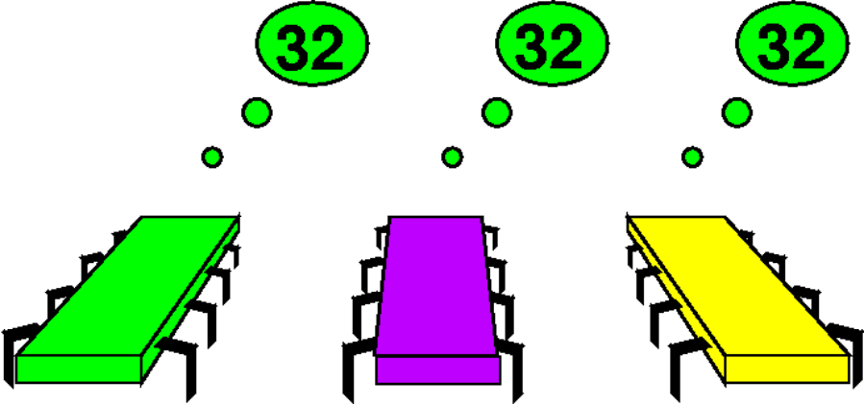
Decision Tasks
Before: private inputs
After: private outputs

Slide 4
Example: 3-Consensus
Before: private inputs
After: agree on one input

Slide 5
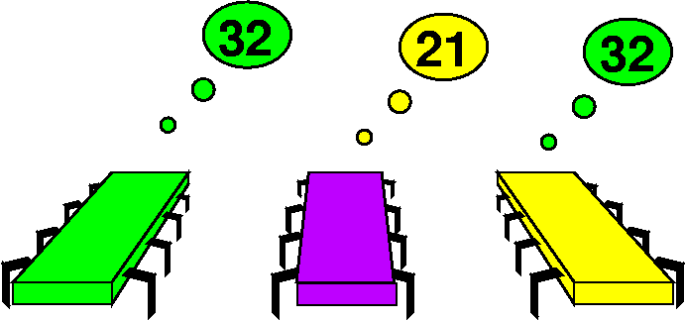
Example: (3,2)-Consensus
Before: private inputs
After: agree on 1 or 2 inputs

Slide 6
A Vertex
Point in high-dimensional Euclidean Space

Slide 7
Simplexes
0-simplex (vertex)
1-simplex (edge)
2-simplex (solid triangle)
3-simplex
(solid tetrahedron)

Slide 8
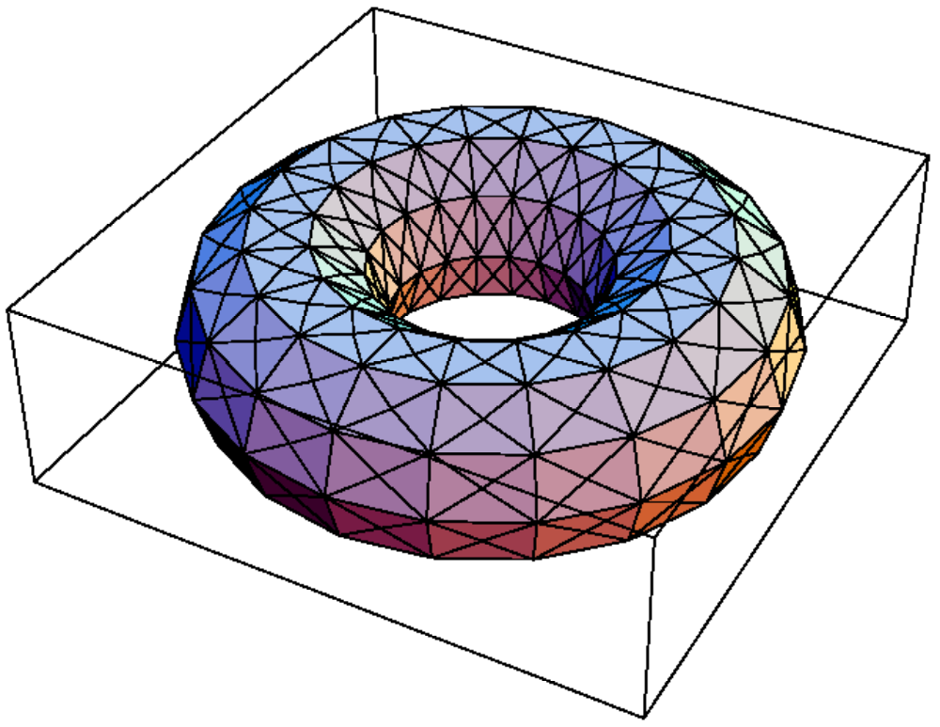
Simplicial Complex

Slide 9
Simplicial Maps
Vertex-to-vertex map
carrying simplexes to simplexes
induces piece-wise linear map

Slide 10
Vertex = Process State
Process id (color)
7
Value (input or output)

Slide 11
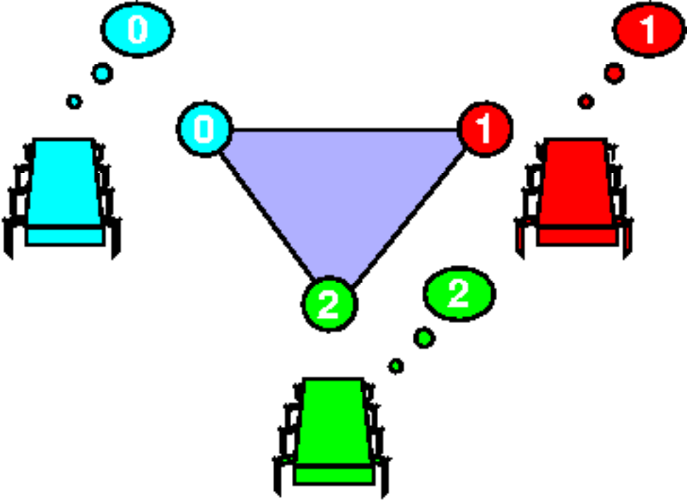
Simplex = Global State

Slide 12
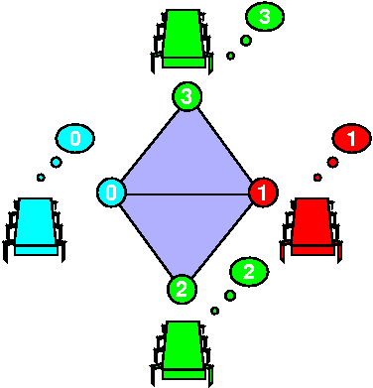
Complex = Global States

Slide 13
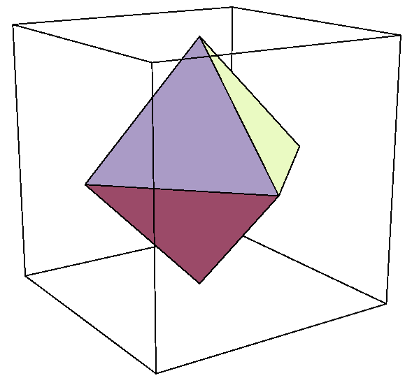
Initial States for Consensus
0
Processes: blue, red, green.
Independently assign 0 or 1
Isomorphic to 2-sphere
the input complex
0
1
0
1

Slide 14
Final States for Consensus
Processes agree on 0 or 1
Two disjoint n-simplexes
the output complex
0
0
0
1
1
1

Slide 15
Problem Specification
For each input simplex S
relation Δ(S)
  defines corresponding set of legal outputs
  carries input simplex
  to output subcomplex

Slide 16
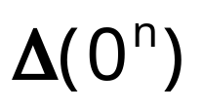

Consensus Specification
0
0
0
1
1
1
Simplex of all-zero inputs

Slide 17
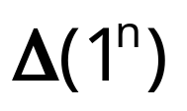

Consensus Specification
0
0
0
1
1
1
Simplex of all-one inputs

Slide 18
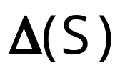

Consensus Specification
0
0
0
1
1
1
Mixed-input simplex

Slide 19
Protocols
Finite program
starts with input values
behavior depends on model ...
halts with decision value

Slide 20
Protocol Complex
Each protocol defines a complex
  vertex: my view of computation
  simplex: everyone’s view
Protocol complex
  depends on model of computation
  what did you expect?

Slide 21

Simple Model: Synchronous Message-Passing
Round 0
Round 1

Slide 22
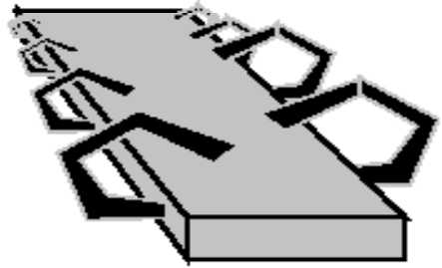
Failures: Fail-Stop
Partial broadcast

Slide 23
Single Input: Round Zero
No messages sent
vertexes labeled with input values
isomorphic to input simplex
0
0
0

Slide 24
Round Zero Protocol Complex
0
No messages sent
vertexes labeled with input values
isomorphic to input complex
0
1
0
1

Slide 25
Single Input: Round One
red fails
green fails
0
0
0
0
0
0
0
0
0
0
0
0
0
0
0
0
0
no one fails
blue fails
0
0
0
0

Slide 26
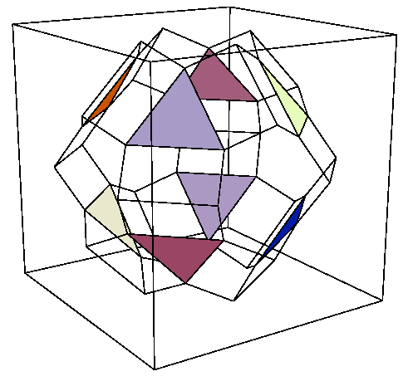
Protocol Complex: Round One

Slide 27
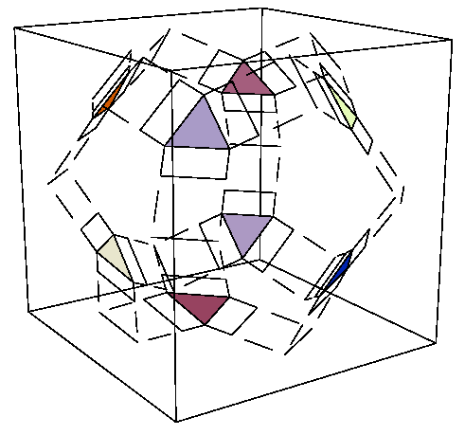
Protocol Complex Evolution
zero
two
one

Slide 28
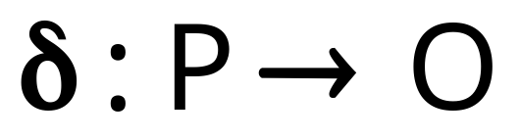
Observation
Decision map
is a simplicial map
  vertexes to vertexes, but also
  simplexes to simplexes
  respects specification relation Δ

Slide 29
Summary
δ
Protocol complex
Δ
Input complex
Output complex

Slide 30
New Model: Asynchronous Failures
???
???

Slide 31
What We Know already
Impossibility results
Algorithms
in various models
  k-Consensus
  (n,k)-consensus
  renaming, etc.

Slide 32
Decidability Results
Biran, Moran, & Zaks 88
  one-resilient message-passing decidable
Gafni & Koutsoupias 96
  t-resilient read/write undecidable
Herlihy & Rajsbaum 97
  lots of other models

Slide 33
Robot Rendez-Vous
(formerly loop agreement)
Complex
loop
three vertexes (rendez-vous points)

Slide 34
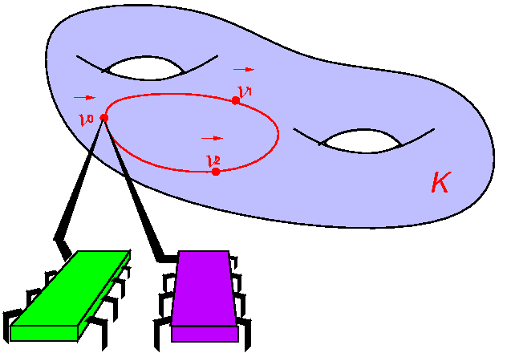
One Rendez-Vous Point
output
input

Slide 35
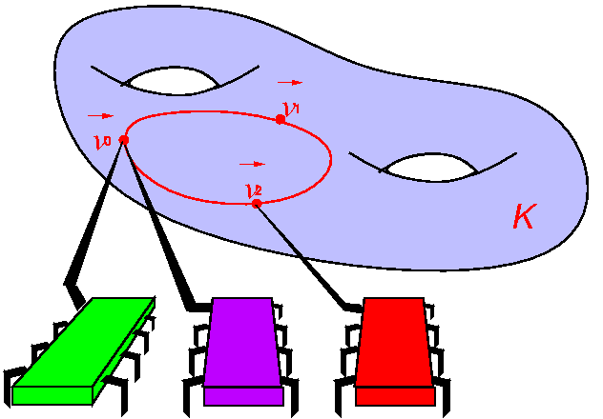
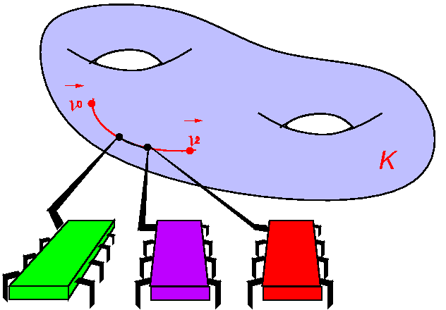
Two Rendez-Vous Points
output
input

Slide 36
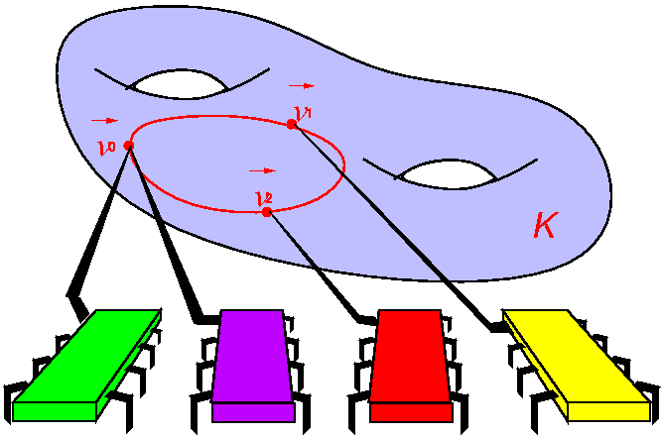
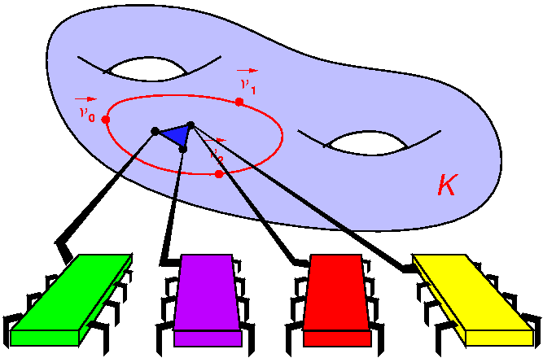
Three Rendez-Vous Points
output
input

Slide 37
Contractibility
contractible
not contractible

Slide 38
Theorem
The Robot Rendez-Vous problem
  in the asynchronous
  message-passing model
has a solution
  if and only if
  loop is contractible

Slide 39
Solvable implies Contractible
Theorem:
  any protocol complex
    in the asynchronous message-passing model
    where more than one process can fail
  is connected and simply connected
    path between any two vertexes
    any loop is contractible
  trust me!
    or consult [Herlihy, Rajsbaum, Tuttle 98]

Slide 40
Solvable implies Contractible
δ
v
0
v
Output Complex
Protocol Complex
All inputs
0

Slide 41
Solvable implies Contractible
δ
v
0
δ
v
1
v
All inputs
1

Slide 42
Solvable implies Contractible
δ
v
v
All inputs or
0
1

Slide 43
Solvable implies Contractible
δ

Slide 44
Solvable implies Contractible
Protocol complex is simply connected
δ
QED

Slide 45
Contractible implies Solvable
f
Map f is continuous

Slide 46
Contractible implies Solvable
φ
Take simplicial approximation

Slide 47
Contractible implies Solvable
φ
Approximate agreement
QED

Slide 48
Decidability
Contractibility is undecidable
  even for finite complexes
  [Novikov 1955]
Reduces to
  the word problem for
  finitely-presented groups

Slide 49
Decidability
Asynchronous message-passing
  decidable for one failure
  undecidable otherwise
But wait, there’s more ...

Slide 50
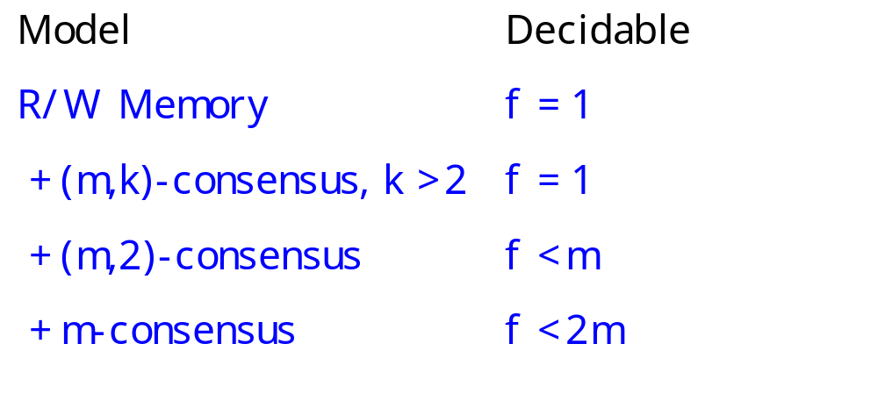
Decidability Results
Weird or what?

Slide 51
Conclusions
Decidability still an open area
  word problem is actually solvable for most reasonable classes of groups
  do these classes correspond to reasonable models of computation?

Slide 52
Clip Art

